Slide 1
Overview of ADAM – Analysis Data Model
Anagha Bhatkhande Varsha Mahajan
V 1.0
Effective date: 01-Nov-2017
Copyright © 2016 Tata Consultancy Services Limited
Notes:
Title Slide
Theme Image area
We need to place appropriate image based on the content of the Presentation
Version No
Release date
PALS logo
TCS logo
Theme 1-a
Align text to the bottom of the logo bottom line
Font size 10pt

Slide 2


Confidentiality Statement
This document contains information which is commercially confidential to Tata Consultancy Services Ltd. ("TCS") and is provided for the sole purpose of permitting the recipient to evaluate the proposal submitted within the document. In consideration of the receipt of this document, the recipient agrees to maintain the information it contains in confidence and not to reproduce or otherwise disclose the contents of this document to any person outside the recipient's evaluation team or nominated advisors. The document may not be used, reproduced or disclosed to others, except as specifically permitted by TCS in writing. The recipient of this document, by its retention and use, agrees to take reasonable endeavours to protect the document and the information it contains from loss or theft.
© 2017 - TATA Consultancy Services Limited (TCS)
TCS confidential

Slide 3
Why do we need ADaM?
Planning
Data Collection
Data Tabulations
Data Analysis
Analysis dataset
Traceability
Protocol
CDASH
SDTM
ADaM
Study Design
LAB
SEND
Tables
Listings
Figures
What is Analysis dataset?
What is ADaM dataset?
Does ADaM have any basic structure?
What are Non-ADaM analysis dataset?
How to differentiate ADaM and Non-ADaM datasets via the naming conventions?
TCS confidential
Notes:
Analysis dataset – An analysis dataset is defined as a dataset used for analysis and reporting.
ADaM dataset – An ADaM dataset is a particular type of analysis dataset that either:
(1) is compliant with one of the ADaM defined structures and follows the ADaM fundamental principles; or
(2) follows the ADaM fundamental principles defined in the ADaM model document and adheres as closely as possible to the ADaMIG variable naming and other conventions.
ADaM has three structures: ADSL (Subject-Level Analysis Dataset), BDS (Basic Data Structure), and OCCDS (Occurrence Data Structure). These three structures correspond to the SUBJECT LEVEL ANALYSIS DATASET, BASIC DATA STRUCTURE, and OCCURRENCE DATA STRUCTURE classes of ADaM datasets
Non-ADaM analysis dataset – A non-ADaM analysis dataset is an analysis dataset that is not an ADaM dataset.
Examples of non-ADaM analysis datasets include:
• an analysis dataset created according to a legacy company standard
• an analysis dataset that does not follow the ADaM fundamental principles.
ADaM datasets are prefixed with ‘AD’
Non-ADaM datasets are prefixed with “AX’

Slide 4
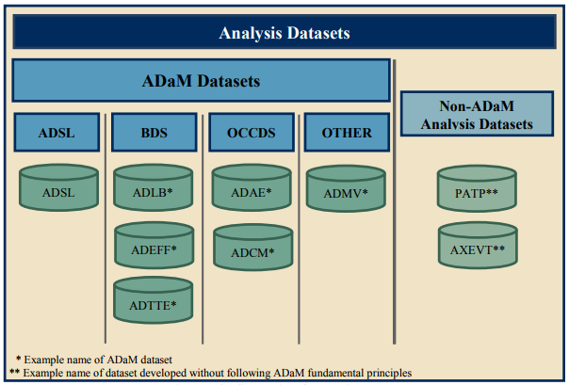
Analysis Datasets
Picture courtesy ADaM Implementation guideline CDISC.org
TCS confidential
Notes:
Analysis dataset – An analysis dataset is defined as a dataset used for analysis and reporting.
ADaM dataset – An ADaM dataset is a particular type of analysis dataset that either:
(1) is compliant with one of the ADaM defined structures and follows the ADaM fundamental principles; or
(2) follows the ADaM fundamental principles defined in the ADaM model document and adheres as closely as possible to the ADaMIG variable naming and other conventions.
ADaM has three structures: ADSL (Subject-Level Analysis Dataset), BDS (Basic Data Structure), and OCCDS (Occurrence Data Structure). These three structures correspond to the SUBJECT LEVEL ANALYSIS DATASET, BASIC DATA STRUCTURE, and OCCURRENCE DATA STRUCTURE classes of ADaM datasets
Non-ADaM analysis dataset – A non-ADaM analysis dataset is an analysis dataset that is not an ADaM dataset.
Examples of non-ADaM analysis datasets include:
• an analysis dataset created according to a legacy company standard
• an analysis dataset that does not follow the ADaM fundamental principles.
ADaM datasets are prefixed with ‘AD’
Non-ADaM datasets are prefixed with “AX’

Slide 5
ADaM Data Structures
Clear and Unambiguous connect between the Analysis datasets and associated Metadata supporting the statistical analyses performed in a clinical study – communicate the content and source of the datasets
Provide Traceability – data’s lineage or relationship between analysis value and its predecessor (derived, imputed)
Readily usable with commonly available software tools
Ease to perform statistical analysis with minimal programming – one proc away
Ease data review and re-creation of specific statistical Analysis
TCS confidential

Slide 6
Traceability
Assumption: Source for ADaM datasets are SDTM
Reality : Source for ADaM can be another ADaM
A CDISC compliant submission includes both SDTM and ADaM datasets ; relationship between SDTM and ADaM must be clear.
ADaM tries to balance ‘Traceability’ and ‘Analysis-Ready’ with a predictable structure
Contains derived data along with directly imported SDTM datasets
In case of records/observation not used for analysis are dropped then appropriate analysis flags are added to ease analysis
Traceability is key for reviewers since it helps identify
Information that exists in the submitted SDTM data
Information that is derived or imputed within the ADaM dataset
The method used to create derived or imputed data
Information used for analyses versus not used for analyses but is included in the dataset to support traceability or future analysis
Requires Traceability
Why Traceability?
TCS confidential
Notes:
In the ADaM model, it is assumed that the original data sources for ADaM datasets are SDTM datasets, even when ADaM datasets are derived from other ADaM datasets. ADaM has features that enable traceability from analysis results to ADaM datasets and from ADaM datasets to SDTM datasets.

Slide 7
Traceability
Two levels of Traceability:
Metadata traceability:
Required for ADaM compliance
Establishes the relationship of the analysis variable to its source dataset(s) and variables by describing the algorithm used to derive or populate it
Establishes the relationship between an analysis result & analysis dataset(s)
TCS confidential

Slide 8
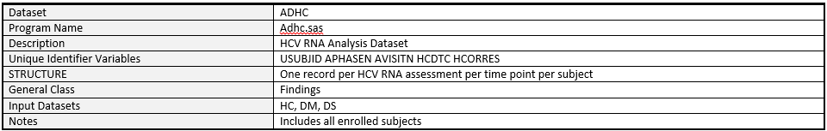
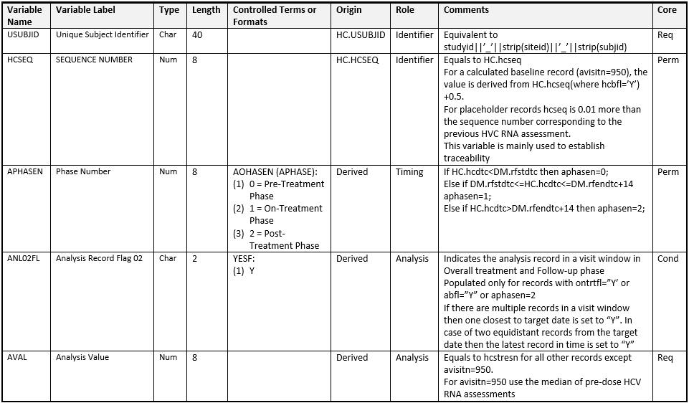
Metadata traceability
TCS confidential

Slide 9
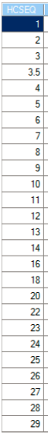
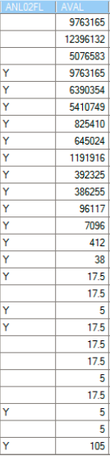
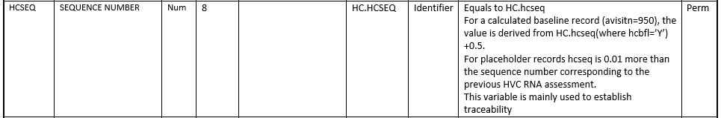
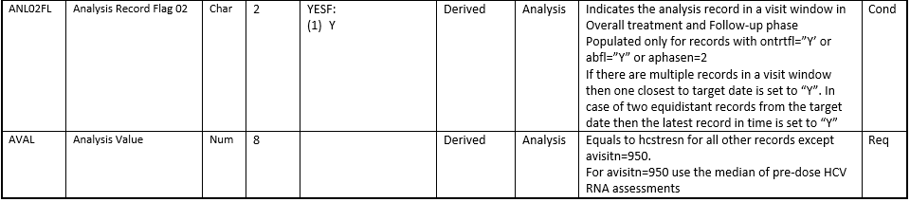
Metadata traceability
Origin
Derivation
Role
Type
TCS confidential

Slide 10
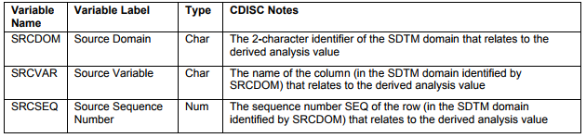
Traceability
Data point traceability:
Implemented if practical and feasible
Points directly to the specific predecessor record from SDTM to ADaM i.e. SDTM variables that are copied in to ADaM and should not be modified
Helps to trace the path of a complex data manipulation
Primary candidates for data point traceability:
SDTM Domain variable value
SDTM Source variable name
Relevant SDTM domain –SEQ value
These 3 with the analysis variable help link back to the source SDTM records
TCS confidential

Slide 11
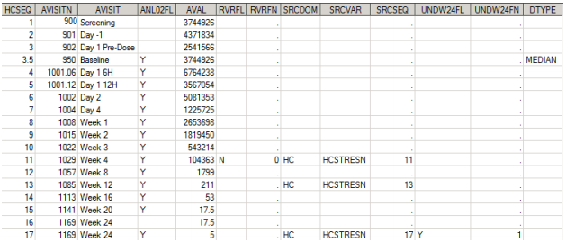
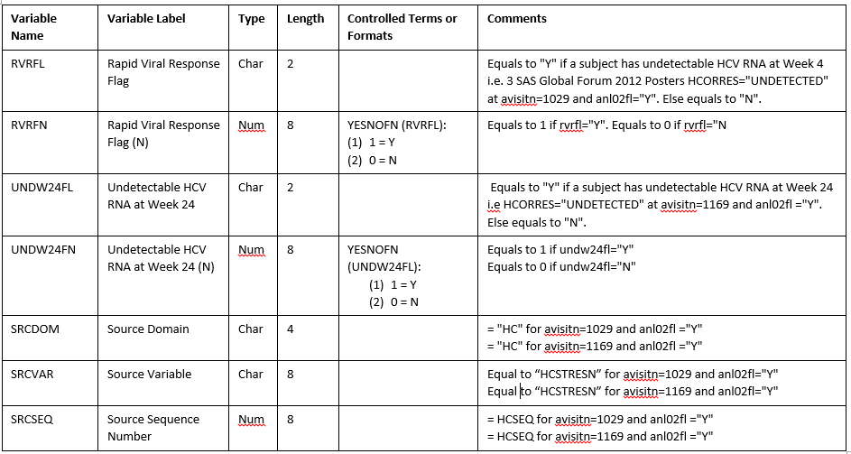
Data Point Traceability
Metadata
Derivation type
Data point
TCS confidential

Slide 12
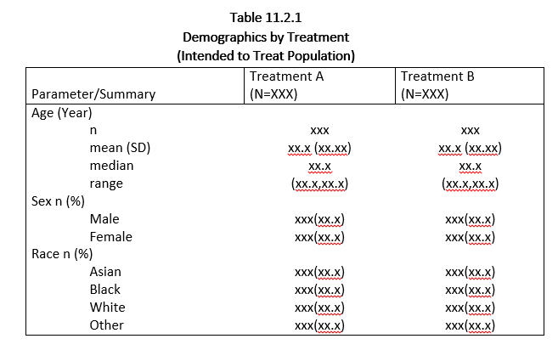
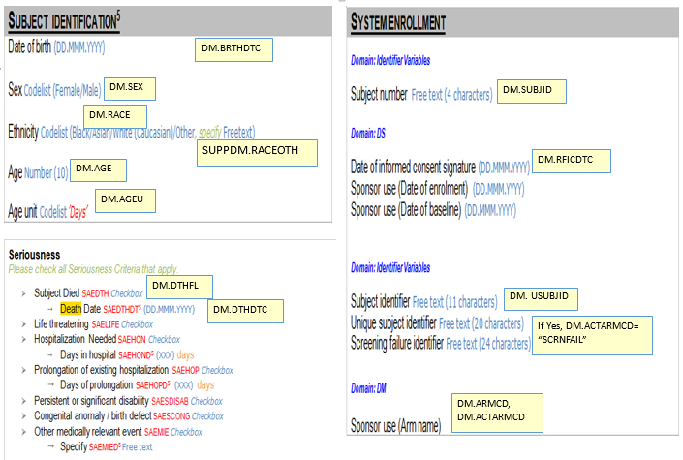
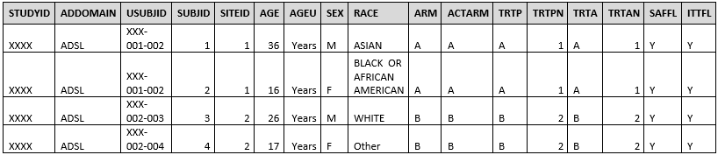
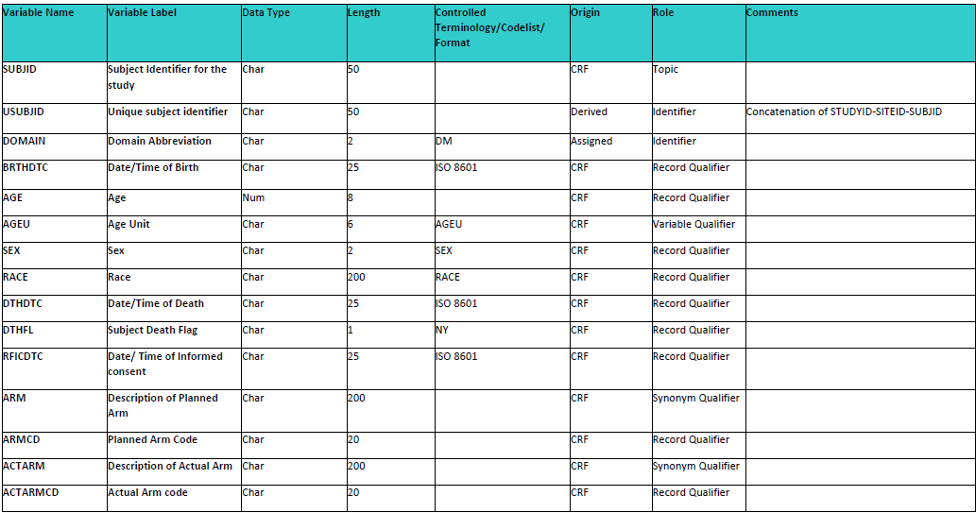
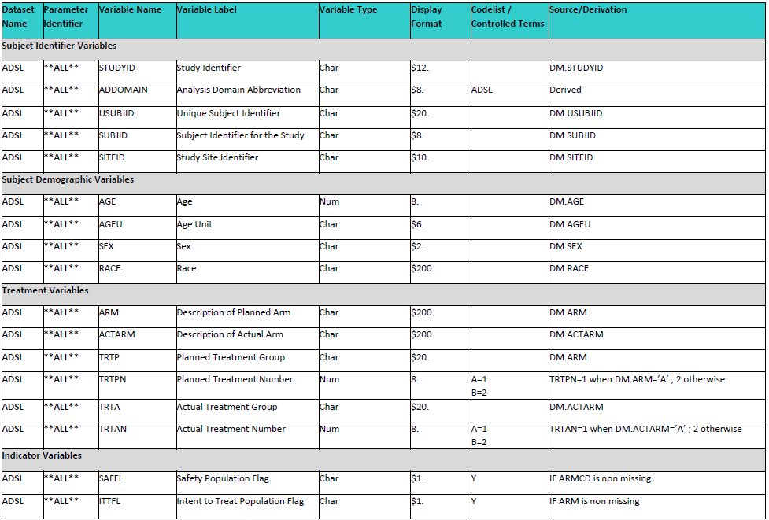
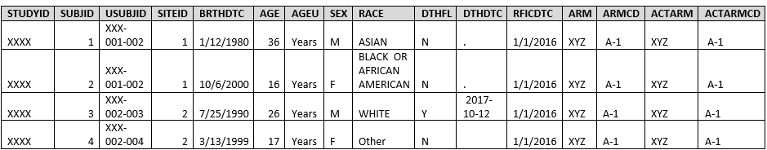
Traceability Cycle
Annotated CRF
Demographic Table
ADSL dataset
DM Metadata
DM dataset
ADSL Metadata
TCS confidential

Slide 13
ADaM Data Structures
Subject Level analysis Structure: The subject level analysis dataset: One record per subject e.g.: ADSL
Occurrence Data Structure (ODS): Contains all the event domains of SDTM. e.g.: ADAE
Basic Data Structure(BDS): Contains one or more records per subject, per analysis parameter, per analysis time point. Mostly contain the finding domains of SDTM e.g.: ADLB
Others
TCS confidential

Slide 14
Standard ADaM Variables
ADaM variables are classified as:
Required (Req) : This variable must be included in the dataset
e.g. : STUDYID, USUBJID, SUBJID, SITEID, etc.
Conditional (Cond) : This variable must be included in the dataset in certain circumstances
e.g. : FASFL, SAFFL, ITTFL, etc.
Permissible (Perm) : This variable may be included in the dataset, but is not required
e.g. : SITEGRy, TRTxxPN, etc.
All ADaM variables are populated as per their classification ; nulls are allowed
TCS confidential

Slide 15
ADaM variable Conventions
The variable conventions are defined to ensure compliance with SAS version 5 transport file format and Oracle constraints
Variable names should be less than or equal to 8 characters in length
Variable names to start with a letter and not underscore
Variable names can be comprised only of letters (A-Z), underscore(_) and numerals (0-9)
Variable labels should be less than or equal to 40 characters in length
All ADaM character variable length should not be more than 200 characters in length
In SDTM if a character variable has length more than 200 characters then the remaining portion is added in SUPP domain but in ADaM it is in the same domain.
General Variable Conventions
TCS confidential

Slide 16
ADaM variable Conventions
General Variable Conventions
Any SDTM variable directly copied in to ADaM dataset should maintain its attributes as in the SDTM (same name, same meaning, same values)
Any ADaM standard variable defined must be used, even if the content is a direct copy of the SDTM variable e.g. AVAL variable in ADLB is just a copy of LBSTRESN the dataset must contain AVAL
In case of paired variables, the secondary variable is presented in the dataset only in the presence of primary variable. Relevant suffix is used only for the secondary variable (e.g. C-character, N-numeric) e.g. TRTP and TRTPN
TCS confidential
Notes:
The primary variable TRTP is already character so it is not named as TRTPC.

Slide 17
ADaM variable Conventions
Character variables converted to Numeric have to be suffixed with ‘N’. In case the variable name is already 8 characters then the last character is replaced by ‘N’
The character date variables converted to Numeric have the following naming convention *DT, *TM and *DTM
Character flag variables end in ‘FL’; numeric in ‘FN’
Variables whose names end in GRy, Gy, or CATy are grouping variables, where y refers to the grouping scheme or algorithm (not the category within the grouping); Numeric version of the variable will use the suffix GRyN (or GyN)
Grouping variable created from a predecessor variable should begin with the name of the variable being grouped e.g. AGEN, AGECAT
General Variable Conventions
TCS confidential
Notes:
Gry is the suffix used for grouping variables, where y refers to the grouping scheme or algorithm. GRy can be abbreviated to Gy to comply with the variable name length limit of 8 characters. Numeric version of the variable will use the suffix GRyN (or GyN).

Slide 18
ADaM variable Conventions
xx Parameter : The xx parameter represents a two-digit period. Valid values are 01–99 e.g. : TRTxxP etc.
y Parameter : The y parameter represents a single-digit grouping or category, an analysis criterion, or an analysis range. Valid values are 1–9 e.g. :SITEGRy etc.
zz Parameter : The zz parameter represents a two-digit index for the zzth record selection algorithm e.g. : ANLzzFL etc.
Variables with xx, y and zz parameters
TCS confidential

Slide 19
Timing variable Conventions
Variables with names ending in
DT are numeric dates
DTM are numeric datetimes
TM are numeric times
DY are relative day variables
Names of timing start variables end with
A ‘S’ followed by the two characters indicating the type of timing (e.g., SDT, STM)
Names of timing end variables end with
An ‘E’ followed by the two characters indicating the type of timing (e.g., EDT, ETM)
TCS confidential
Notes:
The reader is cautioned that the root or prefix (represented by *) of such producer-specified supportive ADaM date, time and datetime variable names must be chosen with care, to prevent unintended conflicts among other such names and standard numeric versions of possible SDTM variable names. In particular, potentially problematic values for producer-defined roots/prefixes (*) include: a. One-letter prefixes. For an example of the problem, if * is Q, then a date *DT would be QDT; however, a starting date *SDT would be QSDT, which would potentially be confusing if the producer intended QSDT to be something other than the numeric date version of the SDTM variable QSDTC.
b. Two-letter prefixes, except when intentionally chosen to refer explicitly to a specific SDTM domain and its --DTC, --STDTC, and/or --ENDTC variables. For an example of an appropriate intentional use of a two-letter prefix, if * is LB, then *DT is LBDT, the numeric date version of SDTM LBDTC. For an example of the problem, if * is QQ, then a date *DT would be QQDT, which would potentially be confusing if the producer intended QQDT to be something other than the numeric date version of a potential SDTM variable QQDTC.
c. Three-letter prefixes ending in S or E. For an example of the problem, if * is QQS, then a date *DT would be QQSDT, which would potentially be confusing if the producer intended QQSDT to be something other than the numeric date version of a potential SDTM variable QQSTDTC.
12. In general, all three of *DT, *TM, *DTM are not required. Include only the *DT, *TM, and *DTM variables needed for analysis or review. However, when a *DTM variable exists, it is good practice to include a corresponding *DT variable.

Slide 20
Flag and Group variables
Subject level population flags in the analysis datasets end in FL and FN (Character and Numeric); values (Yes, No and 1, 0)
Parameter level population flags end in PFL and PFN ; values (Yes,1) null records not included
Record level population flags end in RFL and RFN; values (Yes,1) null records not included
Date time imputation flags end in F
*DTF represent Date imputation flags
*TMF represent Time imputation flags
Both *DTF and *TMF describe the level of imputation
*DTF can take values Blank, D, M, Y
*TMF can take values H, M, S
TCS confidential
Notes:
Primary flagging is subject level
Subgroup is parameter level → based on a group/ category
Sensitivity is record level→ perprotocol

Slide 21
Additional Fragments
Fragments | Definition
BL | Baseline, position relative to type of variable. E.g. SBP01BL, SBP02BL Systolic blood pressure for two periods
CHG | Change, position relative to type of variable. E.g. SBP01CHG Systolic blood pressure change from baseline for period 1
FU | Follow-up, position relative to type of variable. E.g. FUENDT Follow-up end date
OT | On treatment, position relative to type of variable. E.g. ONTRTFL On treatment Flag
RU | Run-in, position relative to type of variable. E.g. RUSDT Run-in start date
SC | Screening, position relative to type of variable. E.g. WEIGHTSC or WTSC
U | Units, suffix
WA | Washout, position relative to type of variable. E.g. WA01SDT, WA01EDT, WA02SDT and WA02EDT Wash out start and end dates for two periods
TCS confidential

Slide 22
ADaM Treatment Variables
Treatment variables are required in all analysis datasets
Actual Treatment variables are required when they do not match with the planned treatment
Variable Name | Label | Type | Source
TRTxxP | Planned Treatment for Period xx | Char | TRTxxP might be derived from the SDTM DM variable ARM. At least TRT01P is required
TRTxxPN | Planned Treatment for Period xx (N) | Num | The numeric code variable for TRTxxP. One-to-one mapping to TRTxxP within a study
TRTxxA | Actual Treatment for Period xx | Char | Subject-level identifier that represents the actual treatment for the subject for period xx. Required when actual treatment does not match planned.
TRTxxAN | Actual Treatment for Period xx (N) | Num | TRTxxAN Actual Treatment for Period xx (N). One-to-one mapping to TRTxxA within a study
TCS confidential

Slide 23
ADaM Common Variables
Identifiers
USUBJID, STUDYID
Demographic Variables e.g. AGE, RACE, SEX etc.
Population Flags e.g. ITTFL, SAFFL, FASFL etc.
Baseline Flag variable i.e. ABLFL
Treatment Variables e.g. TRTxxP, TRTxxA
TCS confidential

Slide 24
Anagha Bhatkhande Varsha Mahajan
Navigating through ADaM IG
November 1, 2017
TCS confidential

Slide 25
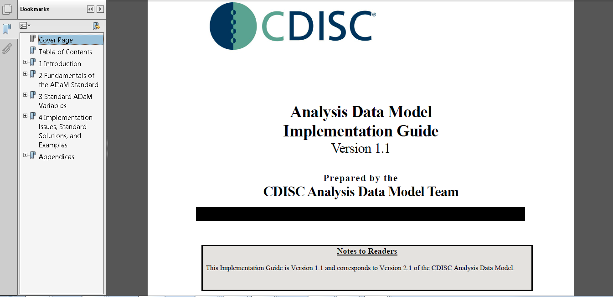
ADaM IG
TCS confidential

Slide 26
End of Session
TCS confidential

Slide 27
Anagha Bhatkhande Varsha Mahajan
ADSL – Subject Level Analysis Dataset
November 1, 2017
TCS confidential

Slide 28
ADSL : Subject-Level Analysis dataset
ADSL dataset and its related metadata are required in a CDISC-based submission of a clinical trial even if no other ADaM datasets are submitted
The structure of ADSL is one record per subject; for any clinical trial design
ADSL is used to provide key facts about the subject ; enabling analysis and interpretation
ADSL does not contain time varying data and endpoints
ADSL is a source for subject-level variables used in other datasets to enable analysis of the BDS dataset
Only one ADSL per study contains variables integral to design and/or randomization
Structure and content make this analysis dataset a cornerstone for any trial
TCS confidential

Slide 29
ADSL : Subject-Level Analysis dataset
ADSL contains variables such as
Subject-level population flags
Treatment variables – planned and actual
Completion status
Important dates
Disease history
Baseline Information
Demographic variables
Stratification variables
Statistical model covariates
Subgrouping variables etc.
TCS confidential

Slide 30
ADSL : Subject-Level Analysis dataset
Notes:
To create ADSL dataset, it is necessary to review the following sections in SAP to understand how the analysis was planned: Population definitions, Schedule of assessments, Definition of baseline values, Analysis covariates and Definition of prior/concurrent medications.
The Demographics Domain Model (DM) and Exposure (EX) domains from the SDTM model are typically required.
Screen Failures : Whether analysis datasets include data for subjects not analyzed (e.g., screen failures) is a sponsor decision and should be communicated with the reviewers or users of the data. If these data are included, they should be incorporated in the appropriate analysis datasets such as ADSL (as opposed to separate datasets for non-analyzed subjects) using appropriate flag variables to clearly differentiate these records. The metadata must specify that these data are included and how to distinguish them.
TCS confidential
Notes:
The SDTM does not provide a separate domain specifically for screen failure data and does not require that the screen failure data be included in SDTM. Data for screen failure subjects, if submitted, should be included in the SDTM Demographics dataset, with ARMCD = ¨SCRNFAIL" and ARM = ¨Screen Failure”. If Screen Failure is captured as a reason on the End of Study form, Sponsors should also include a record in the Disposition dataset indicating when the screen failure event occurred. Reference the SDTMIG V3.1.2 for further guidance on submitting Screen Failure data.

Slide 31
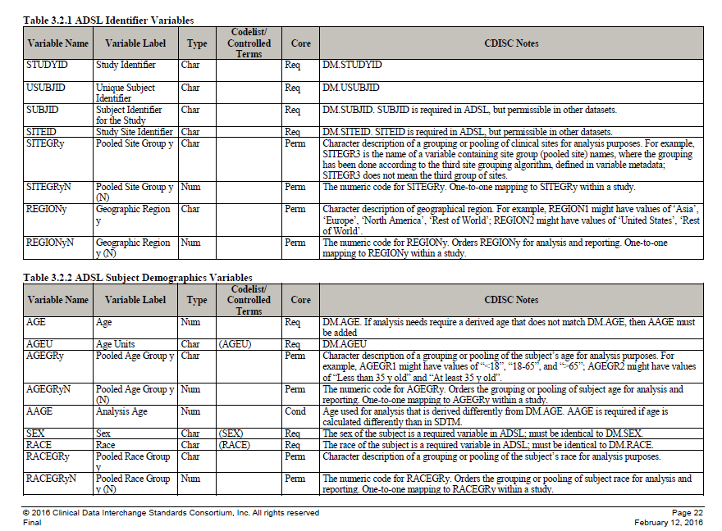
ADSL : Subject-Level Analysis dataset
Must match SDTM variables and values in metadata
TCS confidential

Slide 32
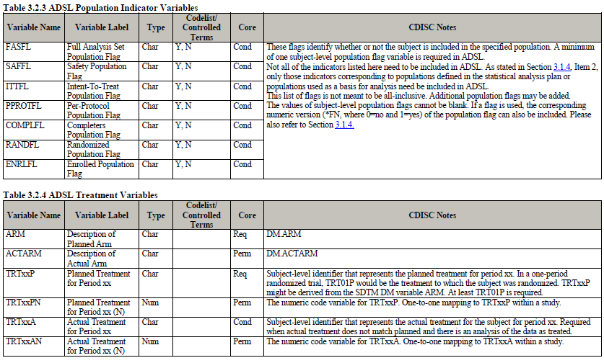
ADSL : Subject-Level Analysis dataset
Must match SDTM variables and values in metadata
Must have at least one population flag
All applicable subject-level population flags must be present
Must have at least one TRTxxP variable
TCS confidential

Slide 33
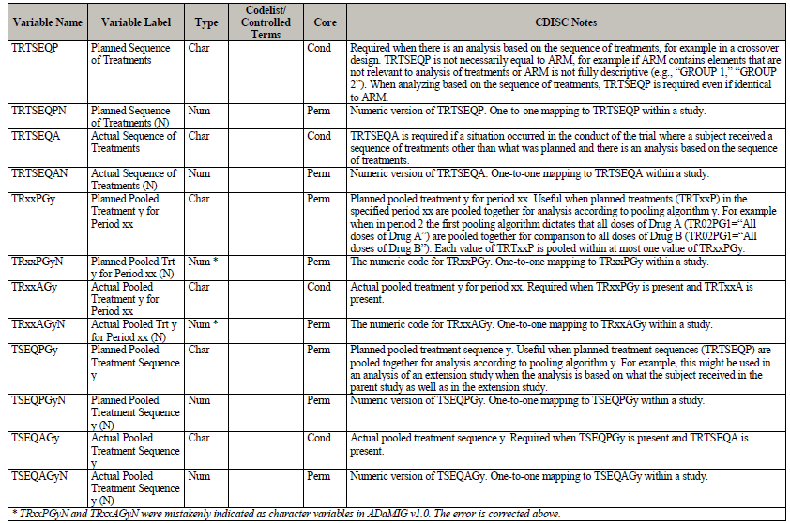
ADSL : Subject-Level Analysis dataset
Added if required as per the study design and analysis
TCS confidential

Slide 34
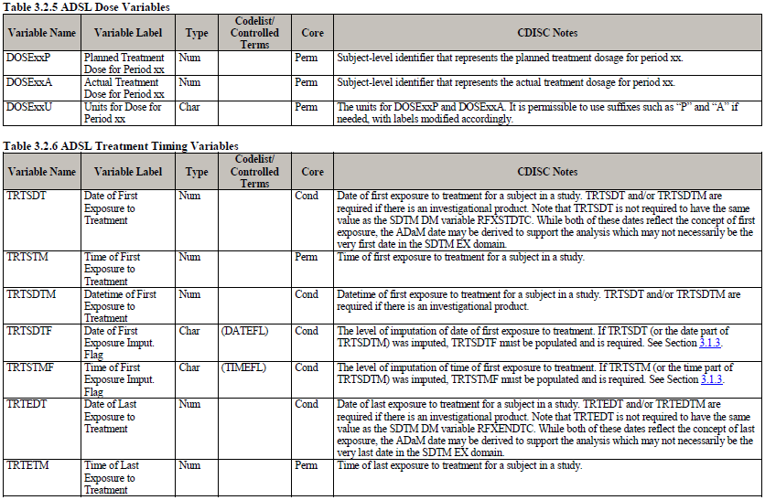
ADSL : Subject-Level Analysis dataset
Selected trial dates required in case of an investigational product
TCS confidential

Slide 35
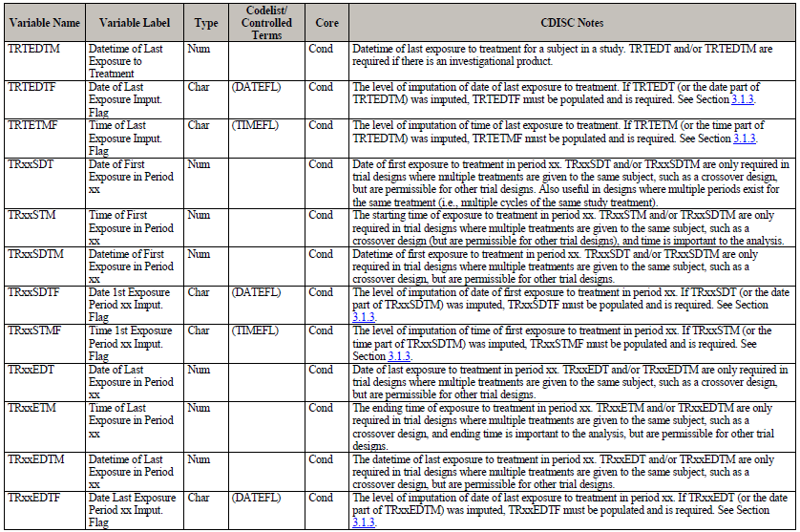
ADSL : Subject-Level Analysis dataset
Added if required as per the study design and analysis
TCS confidential

Slide 36
ADSL : Subject-Level Analysis dataset
Important Notes
A set of timing variables can be included in ADSL only if the definitions are set fixed across the study
Varying timepoint definitions for period start and stop even if required of safety or efficacy analysis should not be included
Additional subject level subperiod, phase timing, trial experience variables can be added
EPOCH variable becomes important to be retained in all ADaM datasets in case of submission
Refer ADaM Implementation Guide V1.1 for all the details
TCS confidential

Slide 37
End of Session
TCS confidential

Slide 38
Anagha Bhatkhande Varsha Mahajan
BDS – Basic Data Structure
November 2, 2017
TCS confidential

Slide 39
BDS : Basic Data structure
BDS dataset contains one or more records per subject, per analysis parameter, per analysis timepoint (only if present)
Classification of variables in the BDS datasets
Subject Identifier variables
Treatment variables
Timing variables
Analysis Parameter variables
Analysis Descriptor variables
Indicator variables
Data point traceability variables
Analysis-Enabling variables
TCS confidential
Notes:
Analysis Visit Windowing variables
Time to Event variables
Toxicity and Range variables

Slide 40
Relation between ADaM BDS and Mock up tables
Statistical Analysis Plan (SAP)
Mock shells for Tables, Listings and Figures
Annotation of Mock shells
Specifications (Metadata) for SDTM and ADaM
Process Flow
SDTM
ADaM
TLF
TCS confidential
Notes:
For pooling of legacy studies when ADaM is directly generated from the shells

Slide 41
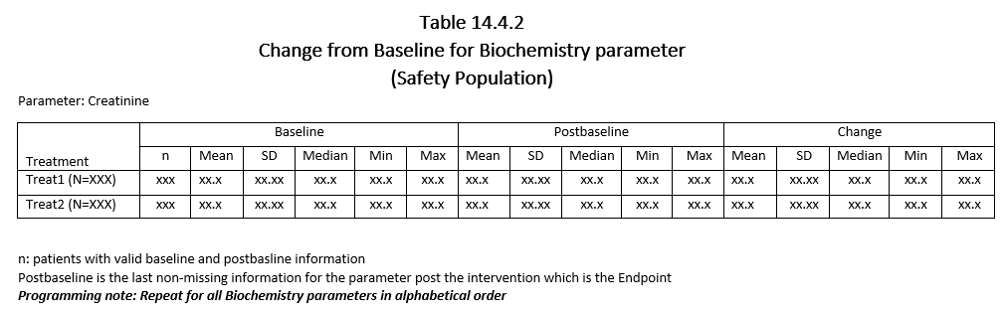
Example Mock shell
Following variables will be needed to create this output:
Population variable – SAFFL
Laboratory Parameter – PARAMCD, PARAM
Treatment variable – TRTAN, TRTA
Baseline information – BASE
Change information – CHG
Postbaseline – AVAL and AVISIT
TCS confidential
Notes:
Stat responsibility

Slide 42
Annotated Mock Shell
ADSL.SAFFL=‘Y’
ADLB.PARMCD=‘CREA’
ADLB.AVAL Where ADLB.AVISIT=‘ENDPOINT’
ADLB.CHG
ADSL.TRTAN
ADLB.BASE
TCS confidential
Notes:
Stat and lead programmer responsible for annotation

Slide 43
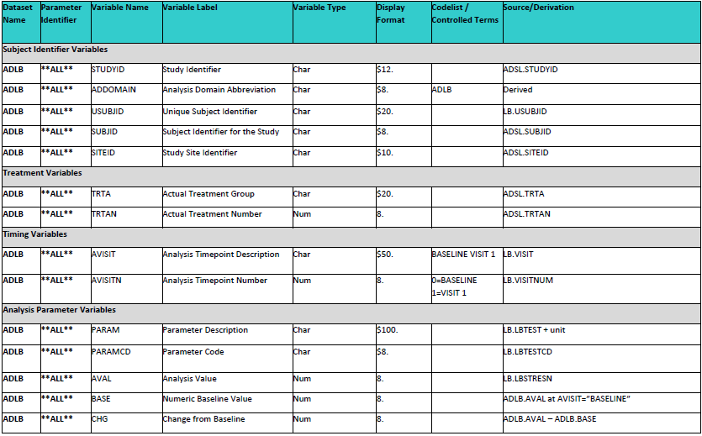
ADLB – BDS Structure
New columns added
TCS confidential

Slide 44
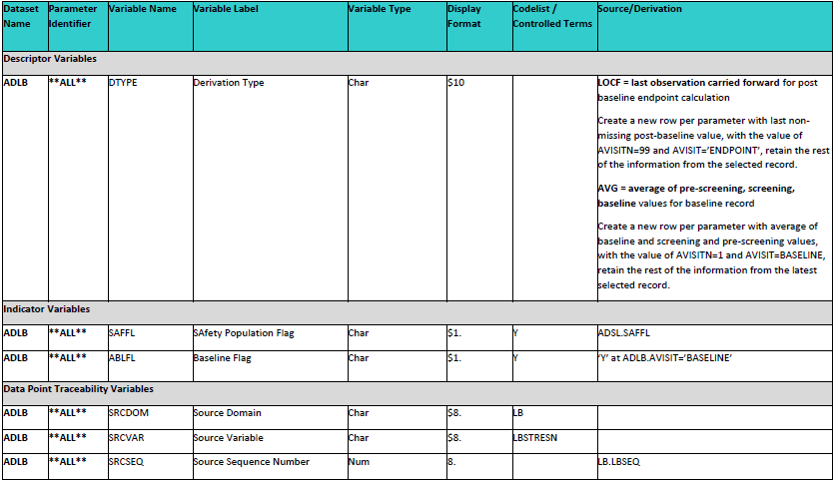
ADLB – BDS Structure
New row created
TCS confidential

Slide 45
ADLB – BDS Data
STUDY | ADDOMAIN | USUBJID | SUBJID | SITEID | TRTA | TRTAN | AVISIT | AVISITN | PARAM | PARAMCD | AVAL | BASE | CHG | DTYPE | SAFFL | ABLFL | SRCDOM | SRCVAR | SRCSEQ
XXXX | ADLB | XXX-001-001 | 1 | 1 | A | 1 | PRE-SCREENING | -10 | CREATININE (mg/L) | CREA | 110 | . | . |  | Y |  | LB | LBSTRESN | LBSEQ
XXXX | ADLB | XXX-001-001 | 1 | 1 | A | 1 | SCREENING | 1 | CREATININE (mg/L) | CREA | 109 | . | . |  | Y |  | LB | LBSTRESN | LBSEQ
XXXX | ADLB | XXX-001-001 | 1 | 1 | A | 1 | BASELINE | 2 | CREATININE (mg/L) | CREA | 110 |  | . |  | Y | Y | LB | LBSTRESN | LBSEQ
XXXX | ADLB | XXX-001-001 | 1 | 1 | A | 1 | BASELINE | 2 | CREATININE (mg/L) | CREA | 109.7 | 109.7 | . | AVG | Y | Y | LB | LBSTRESN | LBSEQ
XXXX | ADLB | XXX-001-001 | 1 | 1 | A | 1 | VISIT 3 | 3 | CREATININE (mg/L) | CREA | 114 | 109.7 | 4.3333 |  | Y |  | LB | LBSTRESN | LBSEQ
XXXX | ADLB | XXX-001-001 | 1 | 1 | A | 1 | VISIT 4 | 4 | CREATININE (mg/L) | CREA | 102 | 109.7 | -7.667 |  | Y |  | LB | LBSTRESN | LBSEQ
XXXX | ADLB | XXX-001-001 | 1 | 1 | A | 1 | VISIT 5 | 5 | CREATININE (mg/L) | CREA | 121 | 109.7 | 11.333 |  | Y |  | LB | LBSTRESN | LBSEQ
XXXX | ADLB | XXX-001-001 | 1 | 1 | A | 1 | ENDPOINT | 99 | CREATININE (mg/L) | CREA | 121 | 109.7 | 11.333 | LOCF | Y |  | LB | LBSTRESN | LBSEQ
TCS confidential

Slide 46
Summary of Key BDS parameters
Parameter (PARAM) and Parameter Code (PARAMCD)
PARAM) describes, and must uniquely and sufficiently identify, the contents of the relevant analysis value variable AVAL or AVALC. PARAMCD is the code for PARAM is map one to one
Differences between PARAM and SDTM xxTEST
SDTM xxTEST is designed to work in conjunction with other variables called qualifiers in order to describe the collected result and PARAM is the only variable that describes AVAL or AVALC, qualifiers are not allowed.
Parameter Category (PARCATy)
PARCATy is used to group parameters into categories
Parameter Type (PARAMTYP)
Parameter Type (PARAMTYP) flags "derived" parameters ; often misleading when used with DTYPE and will be retired in the next version
TCS confidential

Slide 47
Summary of Key BDS parameters
Derivation Type (DTYPE)
DTYPE serves two functions: when populated on a given record,
(1) it indicates that the record is derived from other records within the same parameter and
(2) it identifies the algorithm used to derive the analysis value (AVAL or AVALC) on the record
Baseline Type (BASETYPE)
BASETYPE refers to a definition of baseline that characterizes the value of BASE on that row in case of multiple baseline definition
Baseline Record Flag (ABLFL)
Baseline flag ABLFL must be set to "Y" on the row whose analysis value AVAL is used to populate BASE for that parameter and subject
Analysis Visit (AVISIT)
Analysis visit AVISIT is used to describe the analysis visit or conceptual timepoint characterizing the row
TCS confidential

Slide 48
Summary of Key BDS parameters
BDS Population Flags
Subject-Level Population Flags: Subject-level population flags are contained in ADSL, and can be copied to BDS datasets.
e.g.: ITTFL
Record-Level Population Flags: Record-level population flag variable names end in RFL . A record-level flag is useful when there are reasons for excluding some records within subject and parameter from the analysis.
e.g.: PPROTRFL="Y"
Parameter-Level Population Flags: Parameter-level population flag variable names end in PFL. A parameter-level flag is useful when observed data influence whether or not a subject is considered to be in a population for reporting purposes.
e.g.: for the analysis of a given parameter, a subject is included in the analysis if
(1) the subject is a member of the ITT population, and
(2) for the given parameter, the subject has a non-missing baseline value (BASE) and at least one non-missing post-baseline value of AVAL. For the subjects who meet both conditions, the parameter-level Full Analysis Set population flag FASPFL is set to "Y" on all rows for the parameter
TCS confidential
Notes:
E.g. PCSA

Slide 49
End of Session
TCS confidential

Slide 50
Anagha Bhatkhande Varsha Mahajan
ADaM variable rules
November 2, 2017
TCS confidential

Slide 51
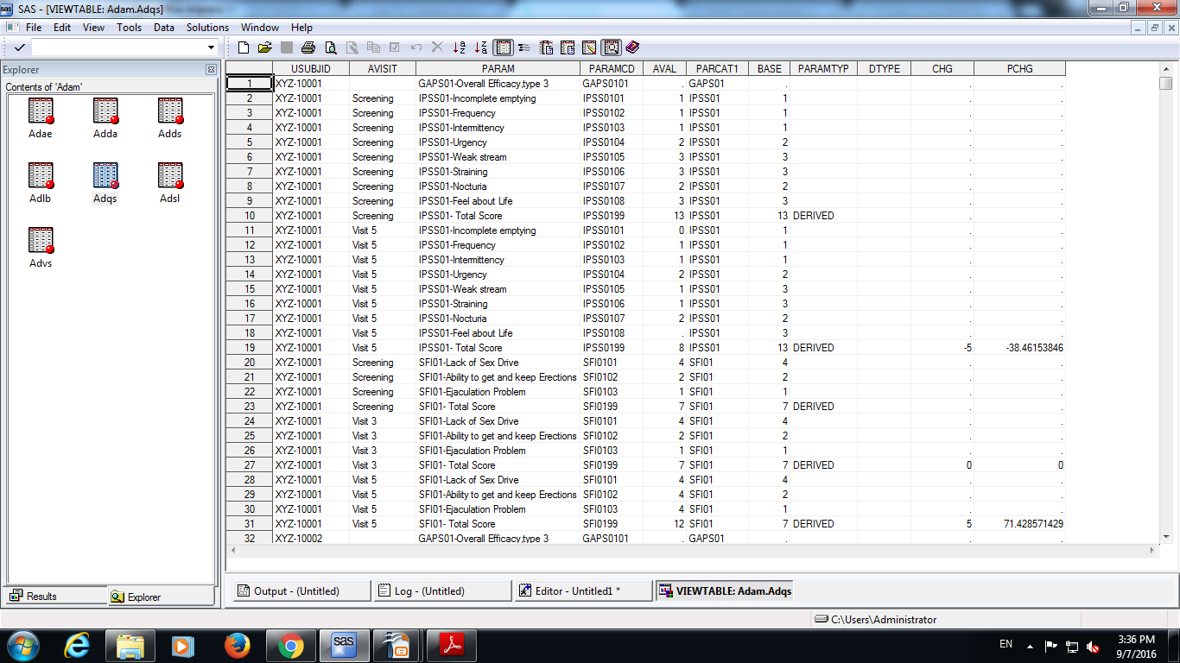
Rules for creation of rows and columns in ADaM
Rule 1 :
A parameter-invariant function of AVAL and BASE on the same row that does not involve a transform of BASE should be added as a new column.
Example of Rule 1: CHG or PCHG as both are derived from AVAL and BASE on the same row and are calculated for all the rows and there is no transformation of BASE.
TCS confidential

Slide 52
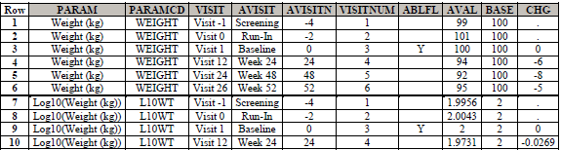
Rules for creation of rows and columns in ADaM
Rule 2 :
A transformation of AVAL that does not meet the conditions of Rule 1 should be added as a new parameter, and AVAL should contain the transformed value
TCS confidential
Notes:
Example of rule 2,3,4,5: The table in the next slide contain a variable PARAM which has the values “SFI01- Total Score” and “IPSS01- Total Score” are the function of more than one row or parameter.

Slide 53
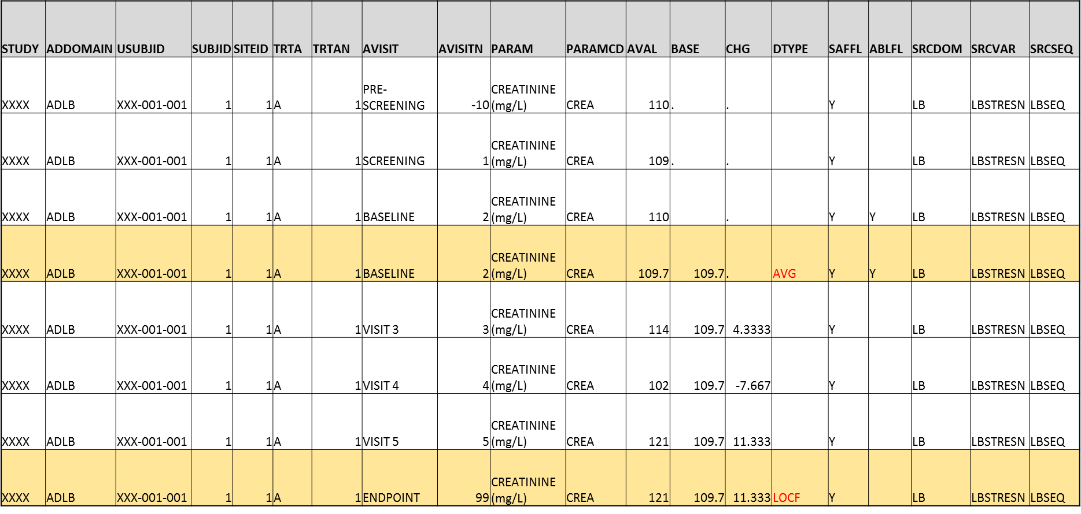
Rules for creation of rows and columns in ADaM
Rule 3 :
A function of one or more rows within the same parameter for the purpose of creating an analysis timepoint should be added as a new row for the same parameter.
TCS confidential
Notes:
Example of rule 2,3,4,5: The table in the next slide contain a variable PARAM which has the values “SFI01- Total Score” and “IPSS01- Total Score” are the function of more than one row or parameter.

Slide 54
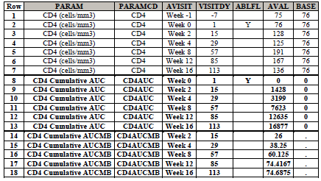
Rules for creation of rows and columns in ADaM
Rule 4 :
A function of multiple rows within a parameter should be added as a new parameter.
Rule 4 is a special case of Rule 2. The functions covered by this rule violate the second condition of Rule 1 (they are not same-row functions of AVAL), and may also violate the first and third conditions.
Let AVAL(t) equal the value of CD4 cell count at post-baseline visit t, and let VISITDY(t) be the planned study day of visit t.
CD4AUC (cumulative daily CD4 count over follow-up) is calculated at any given post-baseline visit as follows:
• CD4AUC at baseline visit is set to 0.
• CD4AUC(t) = CD4AUC(t-1) + [ 0.5 * AVAL(t-1) + 0.5 * AVAL(t) ] * [ VISITDY(t) - VISITDY(t-1) ].
CD4AUCMB (cumulative average change from baseline in daily CD4 count over follow-up) is calculated as
• CD4AUCMB(t) = CD4AUC(t) / [ VISITDY(t) - 1 ] - baseline value of CD4 cell count.
TCS confidential
Notes:
Example of rule 2,3,4,5: The table in the next slide contain a variable PARAM which has the values “SFI01- Total Score” and “IPSS01- Total Score” are the function of more than one row or parameter.

Slide 55
Rules for creation of rows and columns in ADaM
Rule 5 :
A function of more than one parameter should be added as a new parameter
BMI= Weight(kg)/[Height(m)]²
AVISIT | AVISITN | PARAM | PARAMCD | AVAL
BASELINE | 2 | Height (cm | HGT | 157
PRE-SCREENING | -10 | Weight (kg) | WGT | 60
SCREENING | 1 | Weight (kg) | WGT | 61
BASELINE | 2 | Weight (kg) | WGT | 61
VISIT 3 | 3 | Weight (kg) | WGT | 60.8
VISIT 4 | 4 | Weight (kg) | WGT | 60.5
VISIT 5 | 5 | Weight (kg) | WGT | 60
BASELINE | 2 | BMI (kg/m2) | BMI | 24.74745
VISIT 3 | 3 | BMI (kg/m2) | BMI | 24.66632
VISIT 4 | 4 | BMI (kg/m2) | BMI | 24.54461
VISIT 5 | 5 | BMI (kg/m2) | BMI | 24.34176
TCS confidential
Notes:
Example of rule 2,3,4,5: The table in the next slide contain a variable PARAM which has the values “SFI01- Total Score” and “IPSS01- Total Score” are the function of more than one row or parameter.

Slide 56
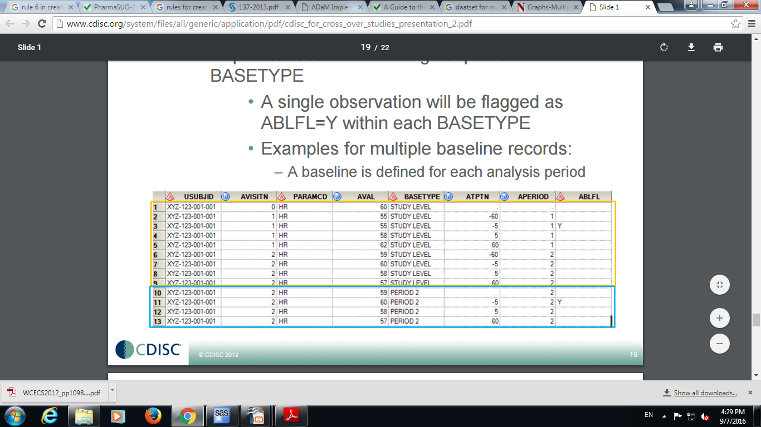
Rules for creation of rows and columns in ADaM
Rule 6 :
When there is more than one definition of baseline, each additional definition of baseline requires the creation of its own set of rows.
TCS confidential

Slide 57
End of Session
TCS confidential

Slide 58
Anagha Bhatkhande Varsha Mahajan
OCCDS - Occurrence Data Structure
November 2, 2017
TCS confidential

Slide 59
Occurrence Data structure (OCCDS)
Occurrence analysis is the counting of subjects with a given record or term, and often includes a structured hierarchy of dictionary coding categories.
e.g. Adverse Events (AE), Concomitant Medications (CM), and Medical History (MH)
The structure for the occurrence analysis dataset is usually one record per each record in the corresponding SDTM domain.
Examples of when the number of records in the analysis dataset would not match the number in SDTM include:
SDTM data contain screen failures but screen failures are not analyzed. In this case, the screen failure records are not needed in the analysis dataset.
Adverse event or concomitant medication, spans several treatment periods and needs to be counted in each. Based on the analysis need, a separate row might be required for each treatment period spanned and analyzed.
An adverse event needs to be analyzed along multiple coding paths. In this case, a row would be needed for each coding path analyzed. An alternate solution, if multiple coding paths are not needed together, would be to put records for each coding path into a separate analysis dataset. E.g. SMQs , period/phase per coding path structure if required by the analysis.
TCS confidential

Slide 60
Occurrence Data structure (OCCDS)
OCCDS variables include
Identifier variables
Dictionary coding and categorization variables (MedDRA for AE and MH and WHOdrug for CM)
Timing variables
Indicator variables
Occurrence flag variables
Treatment variables
Descriptive variables
Refer ADaM structure for OCCDS V1.0 guideline
TCS confidential
Notes:
MedDRA coding SMQ variables

Slide 62
Agenda/Content

Slide 63
Page Title
This Training Material is subject to TCS Document Control Procedure. TCS reserves the right to make additions, modifications or alterations to the existing content or release a newer version of this document.
Softcopy of the latest version of the document is available in the Knowmax PALS Repository
Comments suggestions or queries should be addressed to PALS@tcs.com
Reference: (1) Harrison’s Principles of Internal Medicine. 19th Edition. 2015 McGraw-Hill Education; (2) Labianca R. Annals of Oncology. 2010 May 1;21(suppl 5):v70-7; (3) http://www.cancer.org/acs/groups/cid/documents/webcontent/003096-pdf.pdf. Accessed on Sep 23, 2016.
Notes:
Content Slide
Theme Image area
We need to place appropriate image based on the content of the Presentation
Slide title
This band can be increased in length
Keeping the arrow shape unchanged
References
Will be bottom aligned to PALS logo
Slide content
Currently 12pt
We can increase to 14pt based on the volume of the content in slide and in the presentation
Font size 7-9pt

Slide 64
Section Divider
Sub Title
Notes:
Section Divider style 1
We can use the any one style of section divider in the presentation throughout

Slide 65
Section Divider
Sub Title
Notes:
Section Devider style 2
We can use the any one style of section divider in the presentation throughout

Slide 66
Page Title
This Training Material is subject to TCS Document Control Procedure. TCS reserves the right to make additions, modifications or alterations to the existing content or release a newer version of this document.
Softcopy of the latest version of the document is available in the Knowmax PALS Repository
Comments suggestions or queries should be addressed to PALS@tcs.com.
This Training Material is subject to TCS Document Control Procedure. TCS reserves the right to make additions, modifications or alterations to the existing content or release a newer version of this document.
Softcopy of the latest version of the document is available in the Knowmax PALS Repository
Comments suggestions or queries should be addressed to PALS@tcs.com.
Reference: (1) Harrison’s Principles of Internal Medicine. 19th Edition. 2015 McGraw-Hill Education; (2) Labianca R. Annals of Oncology. 2010 May 1;21(suppl 5):v70-7; (3) http://www.cancer.org/acs/groups/cid/documents/webcontent/003096-pdf.pdf. Accessed on Sep 23, 2016.
Notes:
Content Slide- 2 column

Slide 67
Page Title
This Training Material is subject to TCS Document Control Procedure. TCS reserves the right to make additions, modifications or alterations to the existing content or release a newer version of this document.
Softcopy of the latest version of the document is available in the Knowmax PALS Repository
Comments suggestions or queries should be addressed to PALS@tcs.com.
This Training Material is subject to TCS Document Control Procedure. TCS reserves the right to make additions, modifications or alterations to the existing content or release a newer version of this document.
Softcopy of the latest version of the document is available in the Knowmax PALS Repository
Comments suggestions or queries should be addressed to PALS@tcs.com.
Reference: (1) Harrison’s Principles of Internal Medicine. 19th Edition. 2015 McGraw-Hill Education; (2) Labianca R. Annals of Oncology. 2010 May 1;21(suppl 5):v70-7; (3) http://www.cancer.org/acs/groups/cid/documents/webcontent/003096-pdf.pdf. Accessed on Sep 23, 2016.
Notes:
Content Slide- 2 row / comparison

Slide 68
References
Reference
Reference
Reference
Reference
Reference
Reference
Notes:
Content Slide- 2 row / comparison

Slide 69
Thank You
For any feedback/comment/clarification please contact us at PALS@tcs.com
V NN

Slide 70
Document Release Notice
This XXXXXXX, Version NN, is released for use in Tata Consultancy Services (TCS) with effect from – DD-Mmm-YYYY.
This Training Material is subject to TCS Document Control Procedure. TCS reserves the right to make additions, modifications or alterations to the existing content or release a newer version of this document.
Softcopy of the latest version of the document is available in the ABCDEFG
Comments suggestions or queries should be addressed to PALS@tcs.com.
Date: DD-Mmm-YYYY
Date: DD-Mmm-YYYY
Document Name
Effective Date: DD-MMM-YYYY
V NN
Notes:
Font size 9pt

Slide 71
Change/Revision History
Version No. | Revision Description | Slide No. | Rationale for the Change | Change type (Add/Modify/Delete) | Modified By | Date Modified (DD-Mmm-YYYY)
V NN

